Slide 1
BAVA:
Brain Artery Network Visualization & Analysis Platform
Cherin Lim, David Prendez, Sharan Ranjit S., Kaiyu Zhang

Slide 2
Table of contents
01
02
03
04
05
06
Background
Data
Use Case
Demo
Software Design
Conclusion

Slide 3
01
Background
Brain Artery Network &
Status about Cerebrovascular Disease

Slide 4
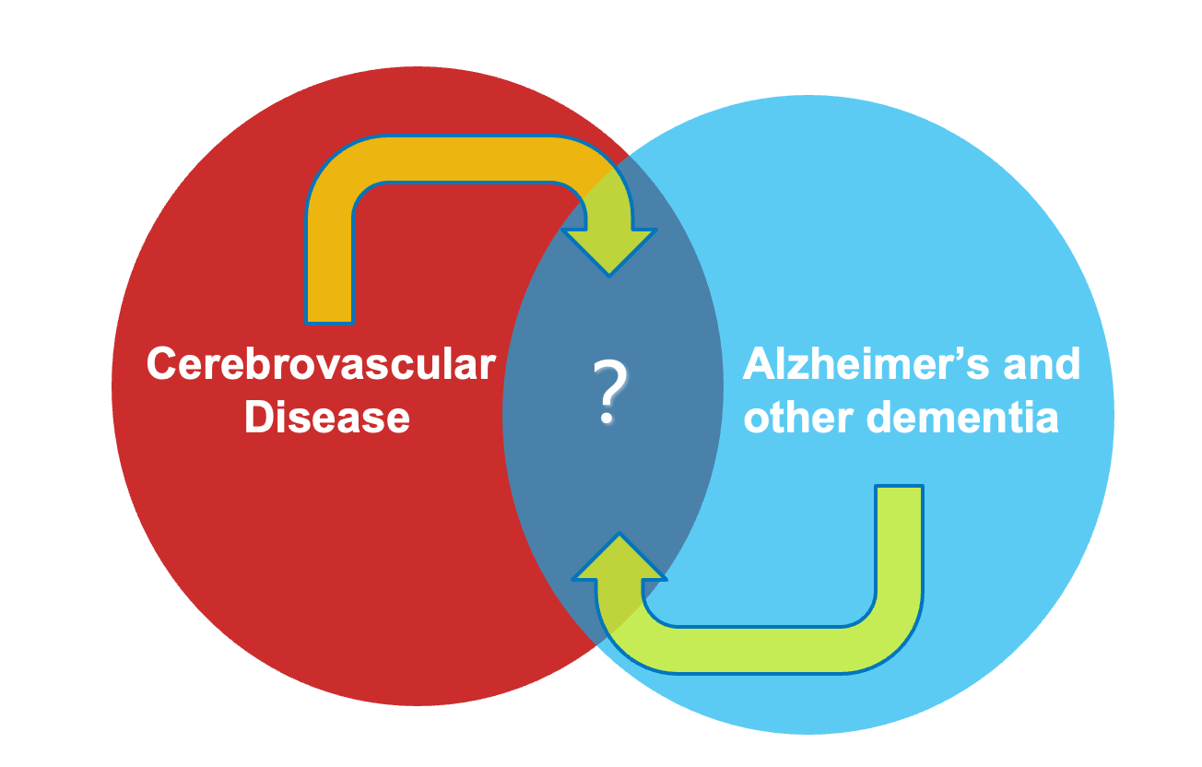


Background
Brain Artery Network
#2
Aging
Oxygen & Nutrient supply
Brain functionality
Waste removal
Cerebrovascular disease is the #2 leading cause of death worldwide
Cognitive function & vascular function

Slide 5
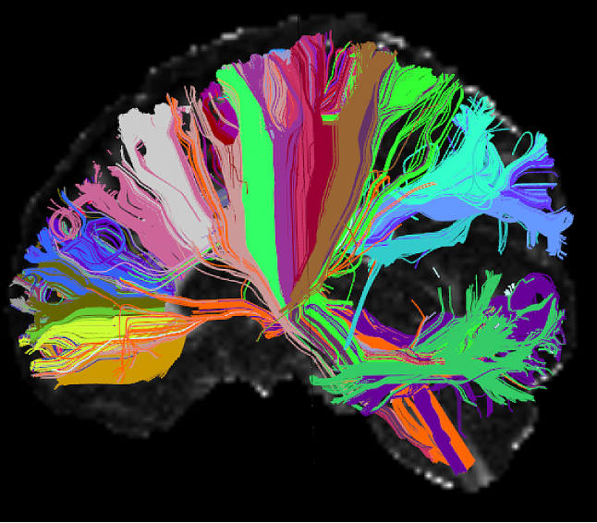

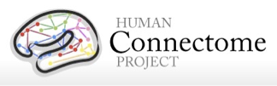
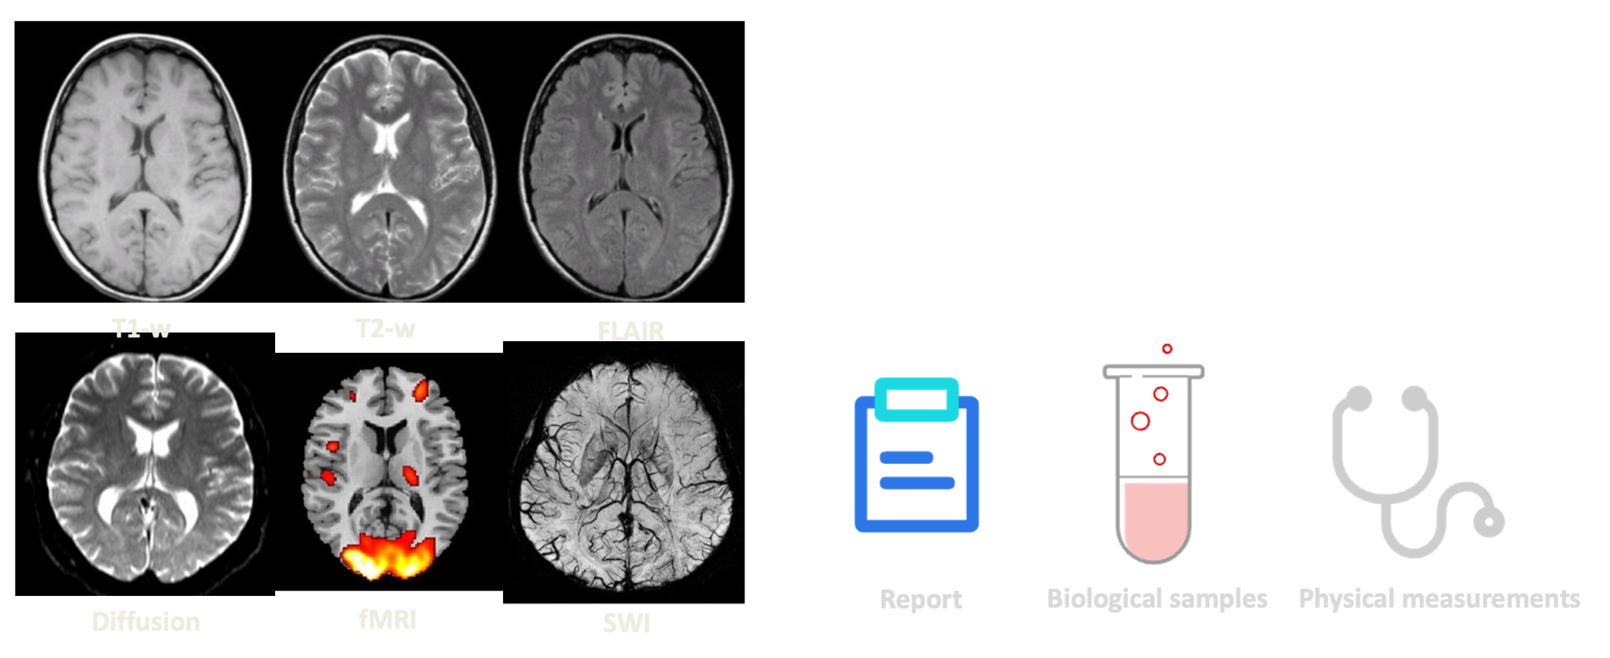
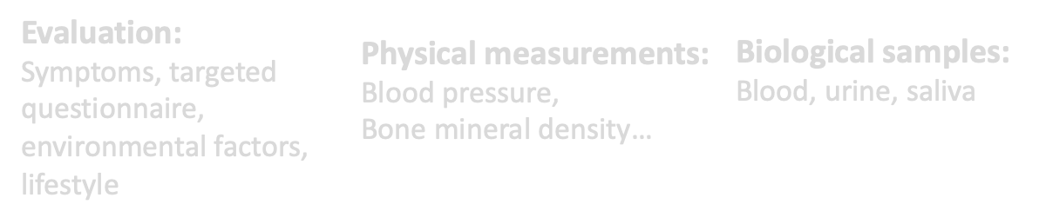
Big Data & Biobank Boom

Slide 6
02
Data
Diverse Medical Dataset

Slide 7
Dataset
BRAVE
CROP
IPH-Supplement
120 male subjects
Hypertension & Control group
Middle-aged
120 male subjects
Hypertension & Control group
Middle-aged
120 male subjects
Hypertension & Control group
Middle-aged

Slide 8
03
Use Cases

Slide 9



Use Cases
Clinical Research:
Researchers and clinicians can use the platform to analyze brain artery networks in patient populations. This could aid in understanding patterns, anomalies, and potential correlations with neurological conditions.
Medical Education:
The software can serve as an educational tool for medical students and professionals, providing interactive visualizations of brain artery networks.
Disease Diagnosis and Treatment Planning:
The platform can assist in the early diagnosis of vascular diseases and conditions, contributing to more accurate and timely diagnoses. Healthcare professionals can also use visualizations for treatment planning, especially in cases involving vascular interventions.

Slide 10
04
Software Design

Slide 11
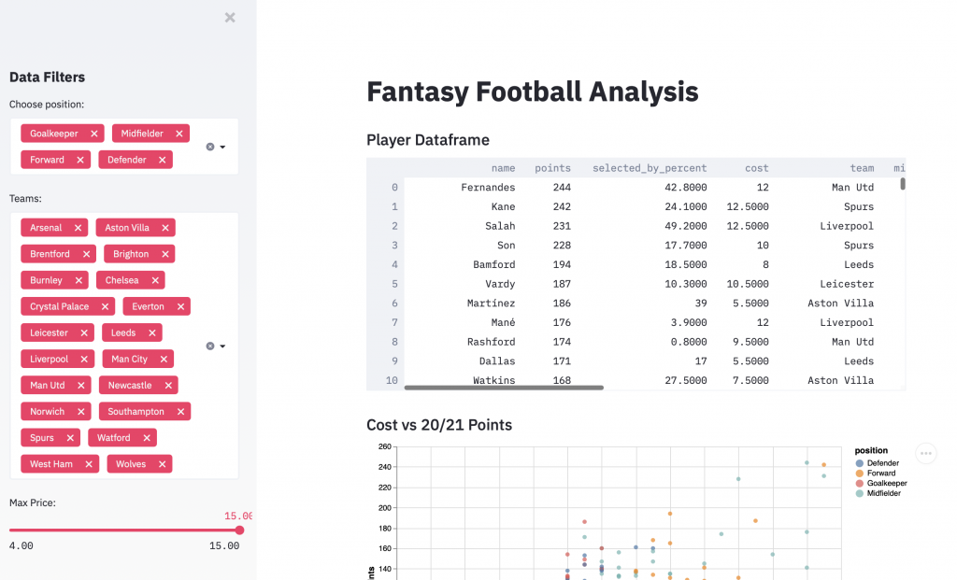
Streamlit
Turns data scripts into interactive web apps, simplifying the process of building user interfaces
Our BAVA platform uses a Streamlit-based web application

Slide 12
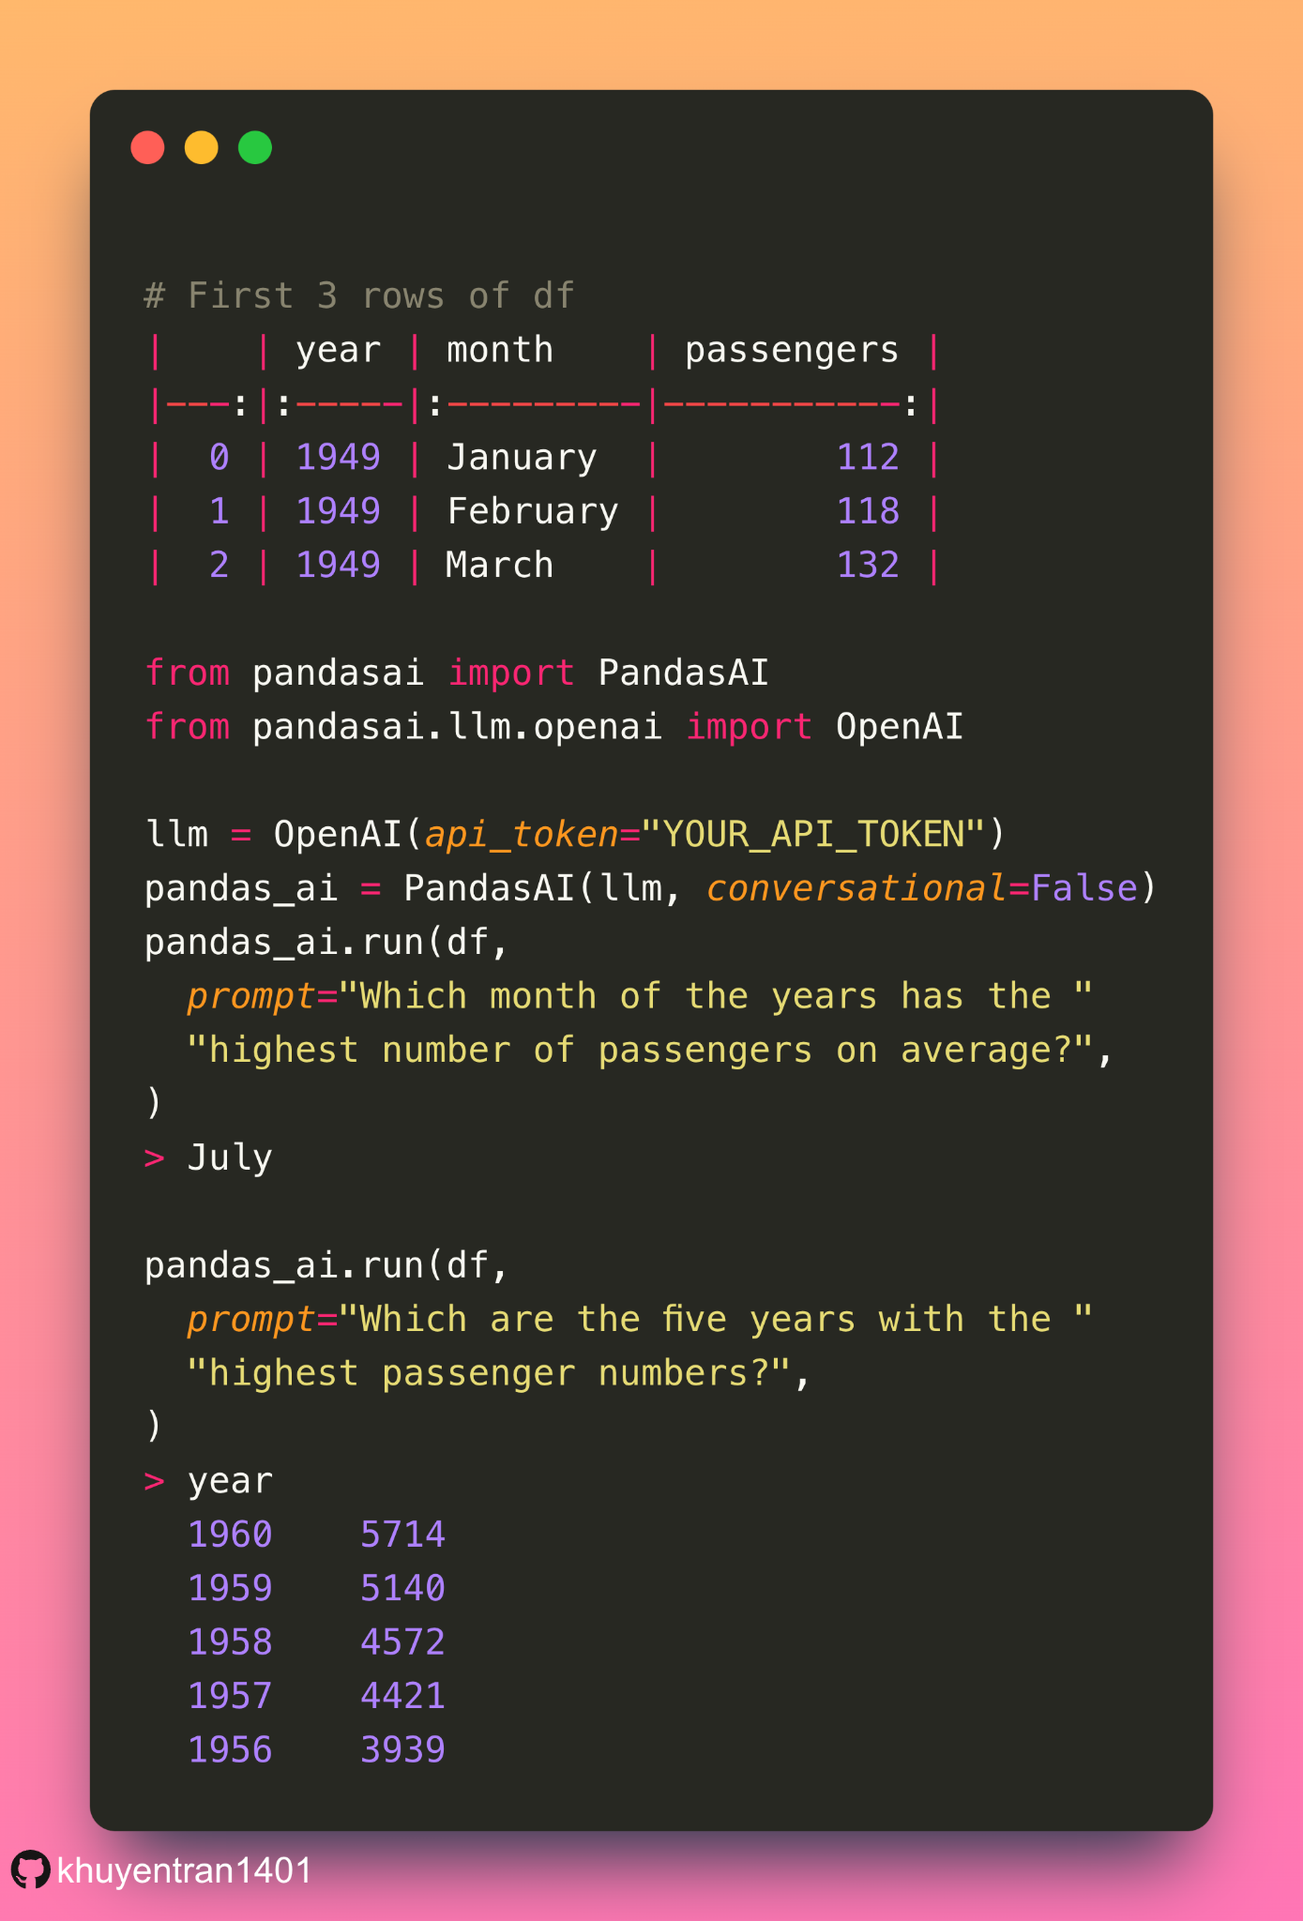
Pandas-AI
Open-source Python package for conversational data analysis
Works similarly to using ChatGPT
Requires an API token from OpenAI which is a paid service
Used with our medical dataset to provide an AI chatbot for users

Slide 13
05
Demo

Slide 14
06
Project Structure

Slide 15
07
Lessons Learned

Slide 16



Lessons Learned
Collaborative Programming
Version control: Learning how to branch, merge, and resolve conflicts efficiently ensured teamwork on different aspects of the codebase simultaneously
Modular design: Breaking down the project into smaller, modular components makes it easier for team members to work on different parts concurrently
Coding standards: Agreeing upon and following coding standards facilitates readability, reduces errors, and ensures that team members can understand and contribute to each other's code more effectively
User-centered Design
Providing visualizations and analyses of complex data requires a user-friendly interface; user feedback and iterative design might have been essential for refining the platform
Visualization Techniques
Developing a visualization platform entails understanding effective ways to represent complex data

